Slide 1

Statistical and Predictive Modeling for Analytics II
Assignment – 2
Multiple Regression
Presented By
Kartik Sojitra (100723768)

Slide 2

Table of Contents
Description of The Problem
Data Evaluation
Standard and Optimized Regression Model
Comparison of Results
Recommendations

Slide 3

Description of the Problem
Mr. John Hughes is examining how the regression with VIF elimination model would better help to distinguish different independent variables that are affecting the dependent variable (CMS).
To solves the above problem he is creating a standard and optimized regression model eliminating the top three independent variables with the highest VIF.
Furthermore, the dataset is likely to be more difficult by analyzing the independent variables and the dependent variable.
In the dataset, there are 8 independent variables (Cement, Blast, Fly Ash, Water, Superplast, CA, FA, Age) and 1 dependent variable (CMS).

Slide 4
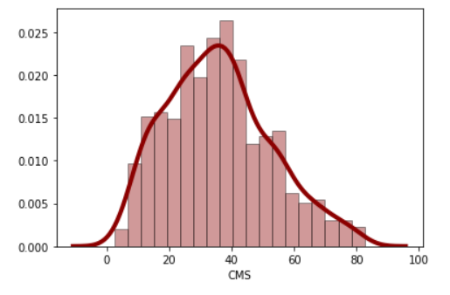
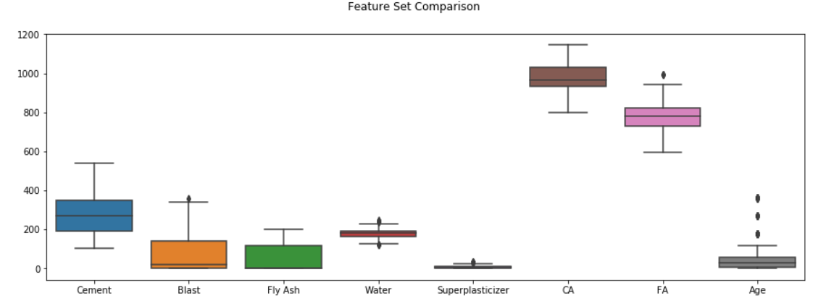
Data Evaluation - Distribution
Std = 16.70
Mean = 35.81
Min = 2.33
Max = 82.60
The curve exhibits that there is left-skewed negative distribution because it has a long tail in the negative direction with few outliers which are shown in the box plot and the mean is to the left of the peak.
For those factors who’s mean and, the standard deviation is high they influence the CMS to affect most as compares to a variable whose gap is little.
Con’t…
Con’t…

Slide 5
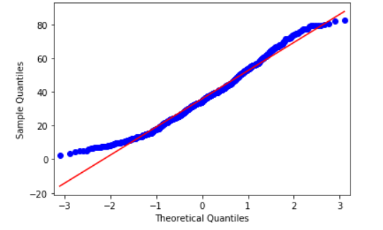
Data Evaluation – Q-Q Plot
The QQ-plot determines that values of CMS do not adapt very well to the normal distribution.
The variation between CMS values and the normal distribution shows to be most noted in the lower left-hand angle of the chart, which compares to the left end of the normal distribution.
The inconsistency is remarkable in the uppermost right-hand edge of the diagram, which resembles the right end of the normal distribution.
Con’t…

Slide 6

Data Evaluation - Normality
Hypothesis Statement:
# p <= alpha(0.05) : Reject Ho, Not normal
# p > alpha(0.05) : Fail to reject Ho, Normal
After conducting the Shapiro-Wilk normality test we got the p-value 0.00 is less than the alpha (0.05), so we can fail to reject Ho states that the predictors are not related to the response variable.
It also says that the sample does not look Gaussian and there is not a normal distribution in the model.

Slide 7
Standard and Optimized Regression model
Standard Regression Model:
CMS = 35.95 + 13.02*(Cement) + 8.95*(Blast) + 5.95*(Fly Ash) – 2.84*(Water) + 1.73(Superplasticizer) + 1.59*(CA) + 2.03*(FA) + 7.21*(Age)
In the standard regression model we are going to identify how different independent variables are affecting the dependent variable (CMS).
The coefficient of cement is 13.027 states that the increase in the quantity of cement content should increase the CMS value on the other hand coefficient of water is -2.84 which means it water reduced the concrete compressive strength if the water content of the concrete is increased.
Optimized Regression Model:
In this model we are eliminating top three independent variables (Water, CA, FA) by highest VIF factor and run the model.
CMS = 35.95 + 10.83*(Cement) + 6.18*(Blast) + 3.91*(Fly Ash) + 4.56*(Superplasticizer) + 6.45*(Age)
We are conducting analysis using 5 independent variables (Cement, Blast, Fly Ash, Superplasticizer, Age) and dependent variable (CMS).

Slide 8


Comparison of Results
Standard Regression Model:
Comparison Regression Model:
The standard regression model has 62% accuracy whereas the comparison regression model has 58% accuracy which depicts that the standard regression model is more accurate than the comparison model.
The value of root mean squared error is 10.66 and 11.18 sequentially, which is more than 10% of the mean value of the percentage of CMS (i.e. 3.50) which implies our algorithm was not exceptionally exact but can still make a sensibly great prediction.
This model value is 62% and 58%, which means the model can explain more than 62% and 58% of the variation, respectively. Also, Both models have 35.95 intercept values.

Slide 9
Recommendation
The value of root mean squared error of optimized regression model is 11.18, which is more than the RMSE of the standard regression model which implies our algorithm was not exceptionally exact but can still make a sensibly great prediction.
The R2 value of the optimized regression model is 58% which means the model can explain more than 58% of the variation.
To solve the problem of optimize regression model Mr. John Hughes can collect more training data, reduce the complexity of the model.
To improve the R2 value and decrease all types of error Mr. John Hughes can transform and modify the dataset.

Slide 10


